Slide 1
Social Network R Overview

Slide 2
Agenda
Data
Tweets
Github
Mylyn
Software
Statnet
Ggplot2
iGraph

Slide 3
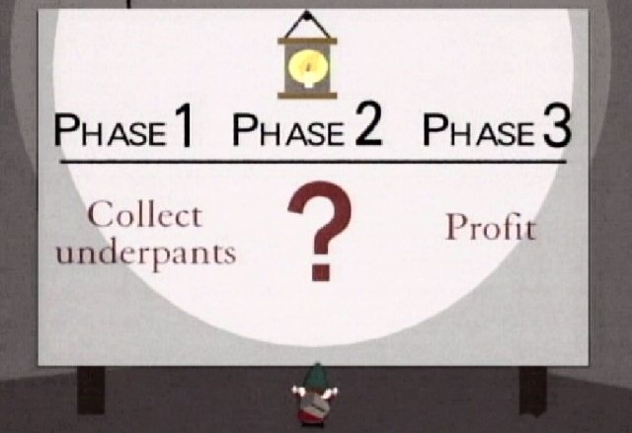
Underpants Gnomes
Motivation
With much discourtesy from the US TV Program “South Park”
Notes:
A problem with much analysis of internet systems today

Slide 4
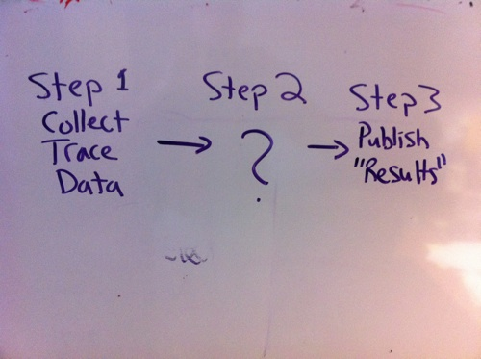
Underpants Gnomes
Motivation

Slide 5
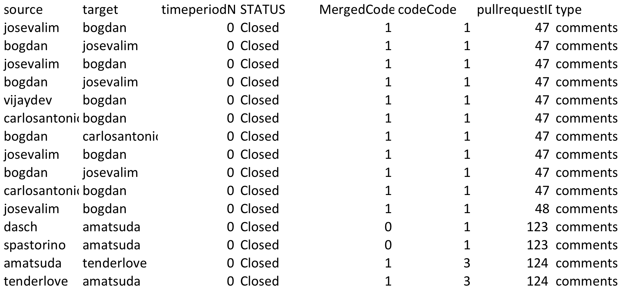
Data: Github

Slide 6
Data: Mylyn

Slide 7
Points
Data
Harvest
Analyze
Data Exists
We harvest it
Analyze It

Slide 8
Twitter: Hashtag Position
Indicates
Affiliation or
A Person or
A Topic

Slide 9
Topic

Slide 10
Person

Slide 11
Another Person

Slide 12
Affiliation

Slide 13
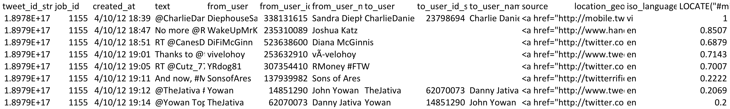
Tweet Data

Slide 14
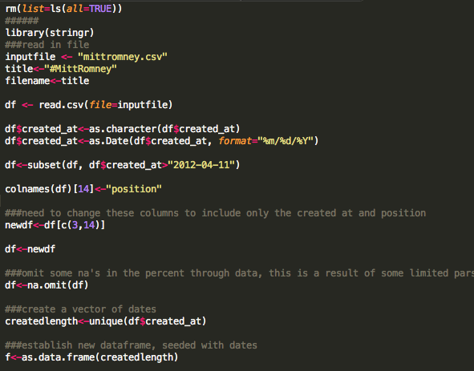
R Code

Slide 15
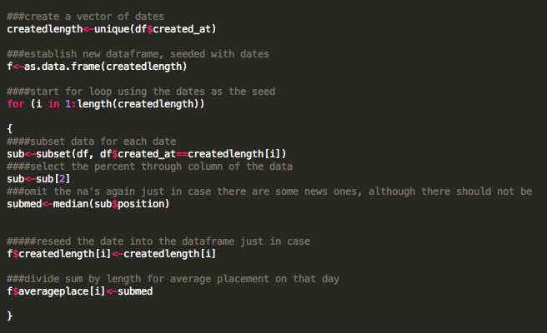
R Code

Slide 16
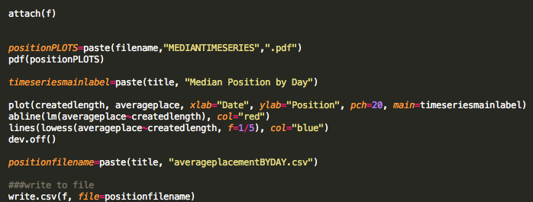
R Code

Slide 17
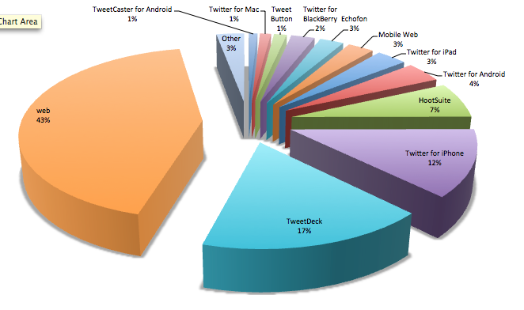
Republican Debates: Device Usage

Slide 18
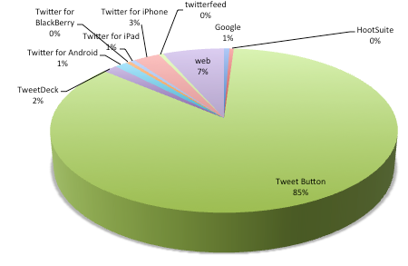
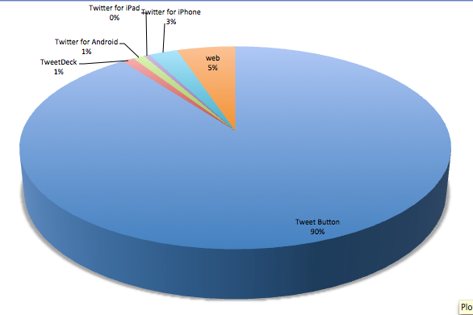
Fox Debate
Dodge
Answer

Slide 19
Data for R
Data
Harvest
Analyze
An Example From the MyLyn Project

Slide 20
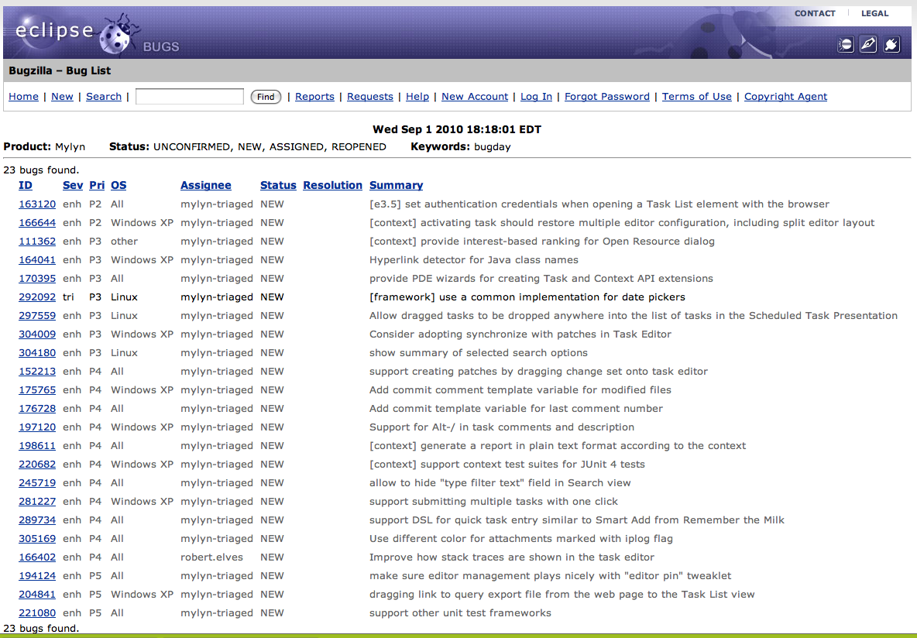
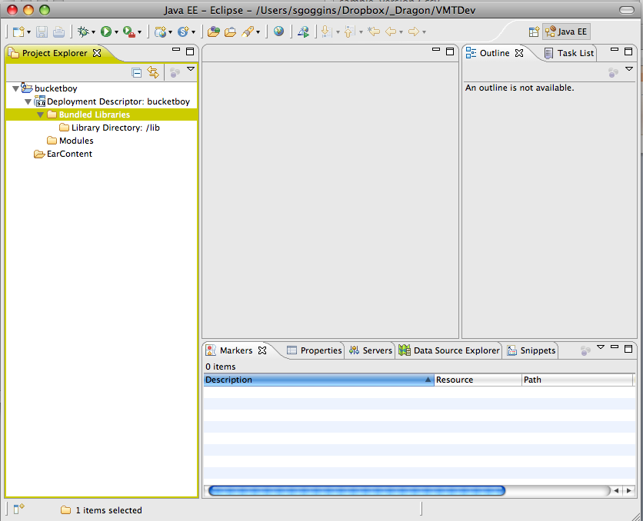
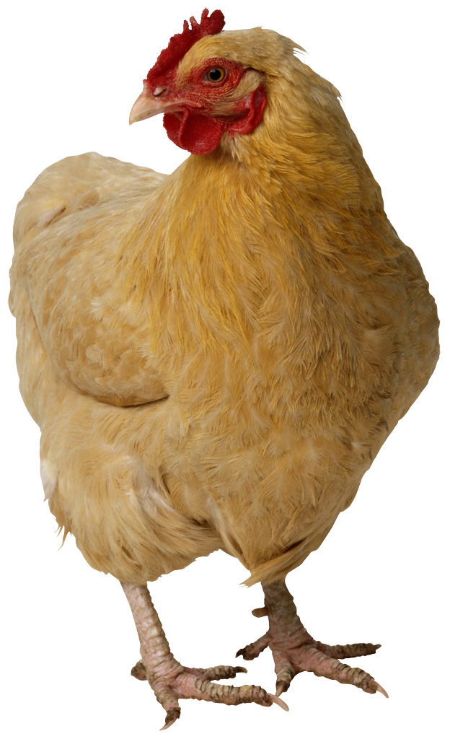
More About MyLyn:
http://tasktop.com/blog/
http://www.eclipse.org/mylyn/
.zip file
MyLyn Context
Uploads
Work
Bug Database
Talk
MySQL Database
Talk
Talk
HTML Parser

Slide 21
Talk Cues
Work
Talk

Slide 22
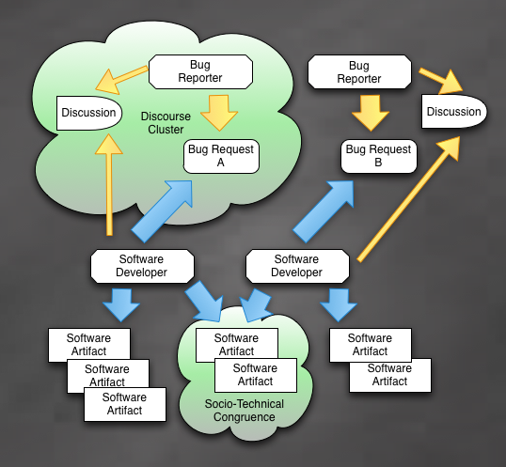
Coordination Requirements & Dependencies
MyLyn Data Has 2 Advantages
for Analysis compared to source
Control systems analysis:
You see files *viewed* together
Discourse on a Bug is directly connected to the files read and edited
Closer connection between analysis of work & talk.
Talk
Work

Slide 23
Harvesting Data for R
Data
Harvest
Analyze
An Example From the MyLyn Project

Slide 24
MyLyn Interaction Datamart
Data
Harvest
Analyze
Developer Context
Files Accessed & Edited
Bugs/Tasks Worked on
Bug/Task Context
Initial Bug Description -> Task
Discussion Related to Bugs
Integrated Repository
Work – Bug/Task Action
Talk – Bug/Task Discussion
Talk
Work
MyLyn
Interaction Warehouse
ETC
CANS
Work
Talk

Slide 25
Analyzing Data with R
Data
Harvest
Analyze
An Example From the MyLyn Project

Slide 26
Analysis Tools
Eight Mylyn Releases (Temporal Analysis)
R Packages Used
TNET
iGraph
Statnet

Slide 27
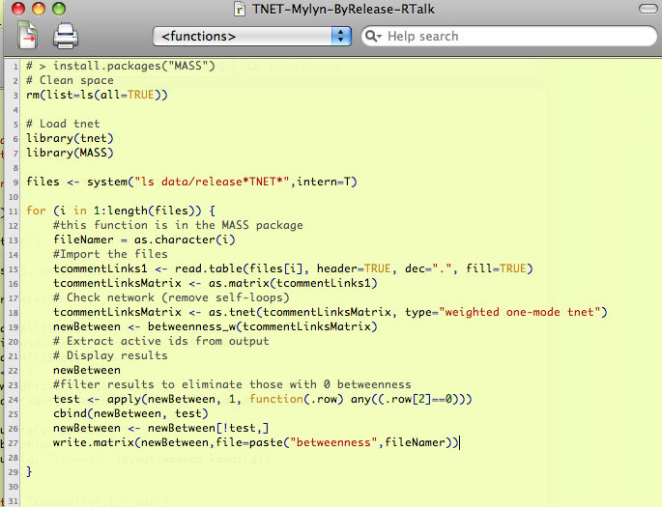
Weighted Network: TNET
Notes:
TNET is a package I would turn you on to if you need to consider weighted network measures. The data structure is a little different than STATNET or iGraph. When you are working with small world data that is relatively closed, the weights of the connection become very important to the analysis.

Slide 28
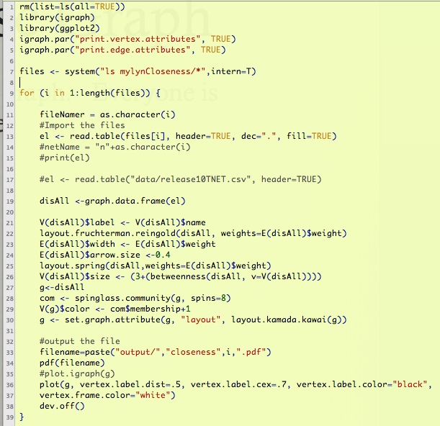
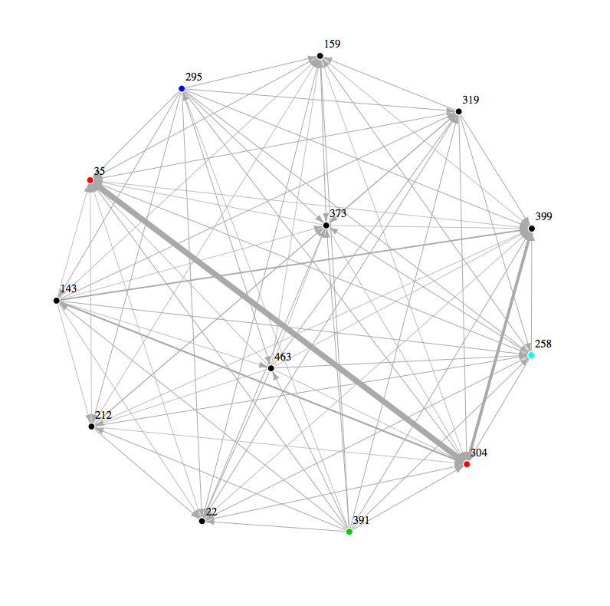
The Dense Graph (Work)
Developers create a dense graph. Not a complete graph, but dense.
Work

Slide 29
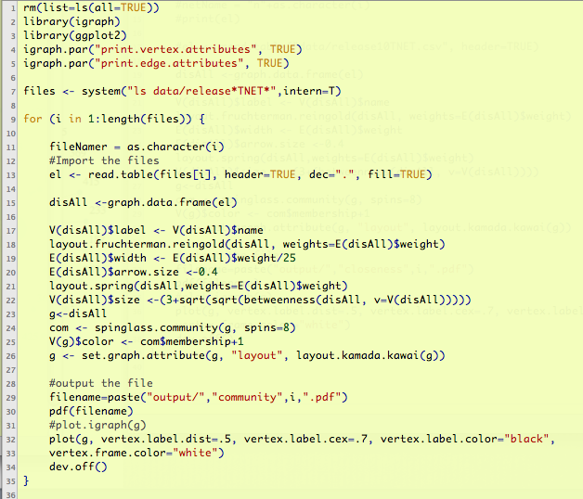
A Sparser Graph (Talk)
Commenter's create a sparse graph
Talk

Slide 30
Release One (2.0) Analysis
Release 1
Discussion
Code
Talk
Work
iGraph

Slide 31
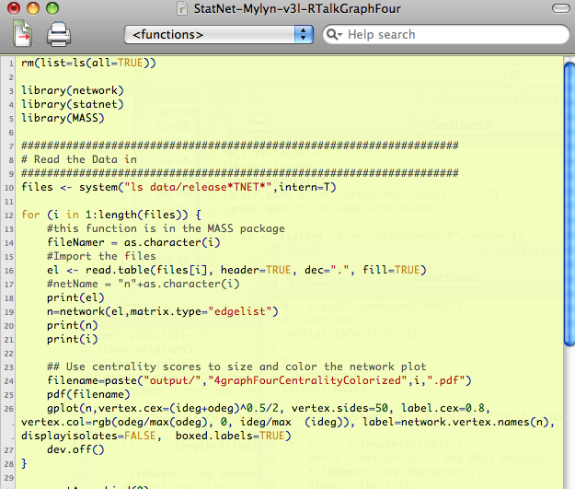
STATNET for Discussion
StatNet
Red = Bug Commenter
Blue = Bug Opener
Release 1
Talk
StatNET

Slide 32
Release One
Work & Talk

Slide 33
Release 1 (2.0) iGraph & Statnet
Talk
Red = Bug Commenter
Blue = Bug Opener
Clusters
Release 1
StatNET
In Degree &
Out Degree
iGraph

Slide 34
Release One (2.0): Filtered
Code
Discussion
Talk
Release 1
Work
Google Summer Coder
304, 373, 399 & 143 form
The Strongest Connections
In both networks
Red = Bug Commenter
Blue = Bug Opener
Notes:
Here we have filtered the developer code for the strongest connections.

Slide 35
Release One (2.0): Filtered
Code
Work
Discussion
Talk
Release 1
457, 391 & 159 –
Comment & Open
Google Summer Coder
304, 373, 399 & 143 form
The Strongest Connections
In both networks
Red = Bug Commenter
Blue = Bug Opener
Notes:
Here we have filtered the developer code for the strongest connections.

Slide 36
Compare Over Time
First & Last Release

Slide 37
Release 1 (2.0) Compared to Release 8 (3.3)
Release 1
Talk
Release 8
304, 399, 143, 159, 173, 373
399, 118, 304, 159, 391, 416
StatNET & ordinary plotting

Slide 38
Release 1 (2.0) Compared to Release 8 (3.3)
Work
Release 1
143 & 304 disengaged
Or missing entirely
Release 8
304, 373, 399 & 143
Two disconnected
Graphs in release 8
iGraph

Slide 39
Release Eight
Work & Talk

Slide 40
Release 8 (3.3): Filtered
Discussion
Code
Release 8
Talk
Nobody is
“Just Blue”
Work
Red = Bug Commenter
Blue = Bug Opener
Notes:
304 & 399 are the story
Statnet is centrality.
89, 276 & 301 are commenters who do not write code.

Slide 41
Release 8 (3.3): Filtered
Release 8
Discussion
Code
Talk
Work
Notice 416 in Talk & Second Coder Graph
Red = Bug Commenter
Blue = Bug Opener
Notes:
416 is part of the disconnected graph, and has two other folks connected to it. That person also shows up in the discussion graph.

Slide 42
Release 8 (3.3) iGraph & Statnet
399, 118 & 159 are significant, But play with different clusters of Other people.
Release 8
Talk
Red = Bug Commenter
Blue = Bug Opener
Clusters
StatNET
In Degree &
Out Degree
Blue
Cluster
iGraph

Slide 43
Releases One → Eight
High Level Views Over Time

Slide 44
Discussion, Releases 1 – 8
Where there is no color,
There are multiple, incomplete
Graphs.
Notes:
When the graph is connected in a community of this size, it may indicate some level of cohesiveness that does not exist when the graph is incomplete. We know that major changes took place during the periods leading up to 3.3, and it is interesting to us that the final release we studied shows a complete discussion graph once again. It suggests that a new, larger community with several clusters has emerged. And the structure is different than it was the last time.

Slide 45
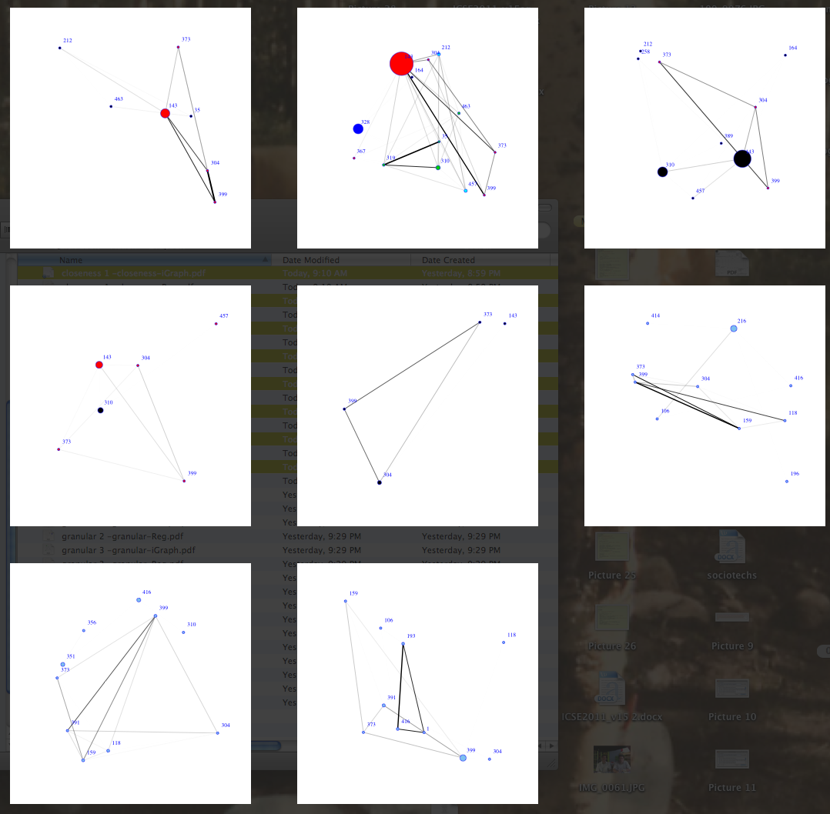
Code, Releases 1 – 8
One Possible explanation:
A few central
People who slowly but
Observably begin to engage
Other contributors in
An open source software
Development project.
Structure evolves
Key Groups Evolve
iGraph

Slide 46
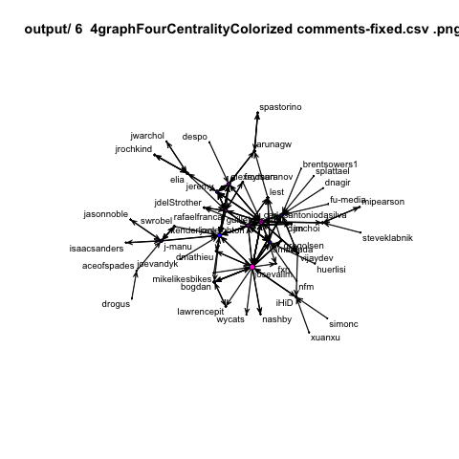
Github: Longitudinal

Slide 47
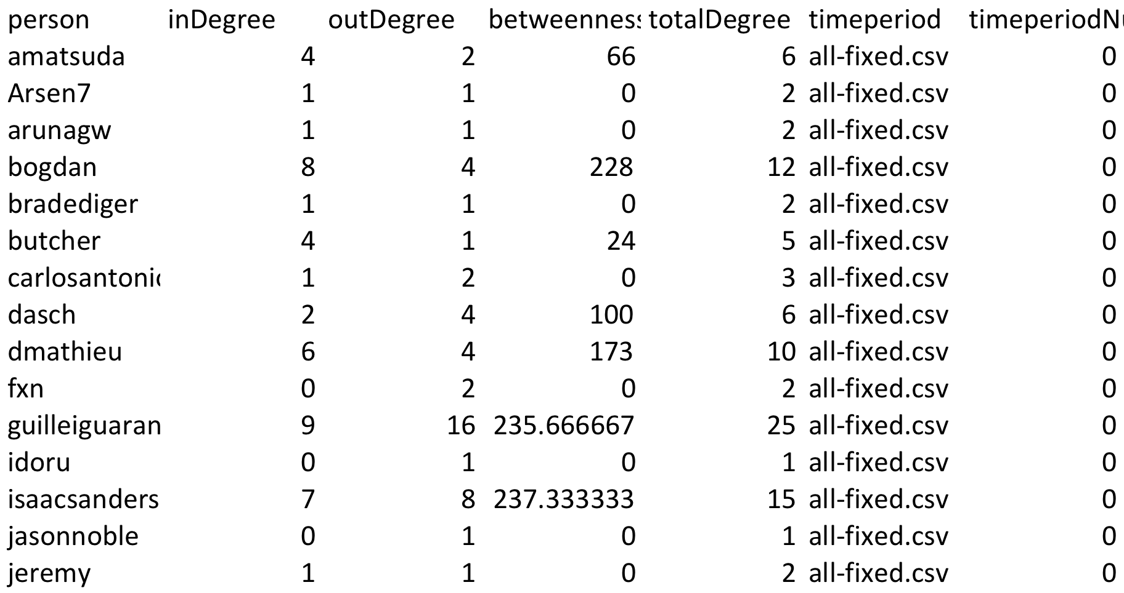
Github Statnet Summaries

Slide 48
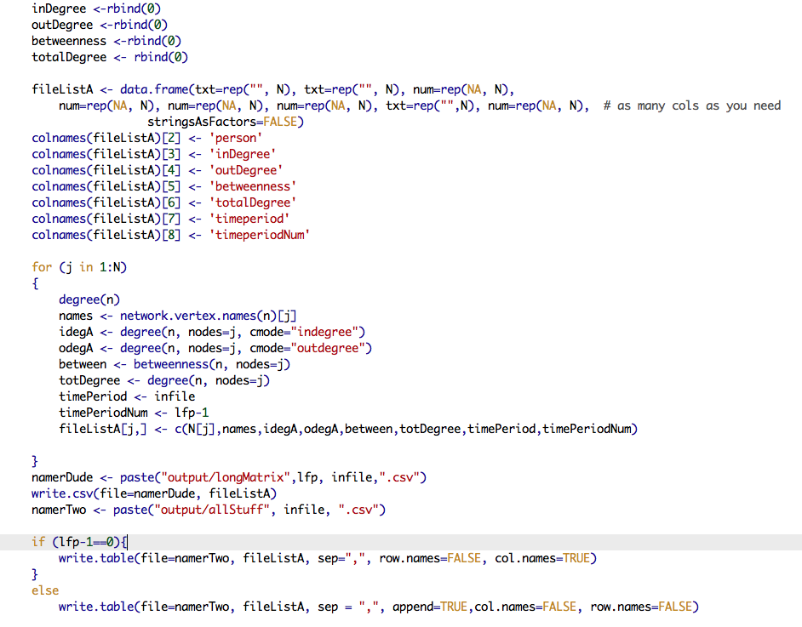
Built with This R Code

Slide 49
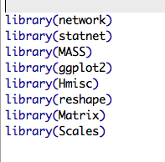
Longitudinal Network Libraries

Slide 50
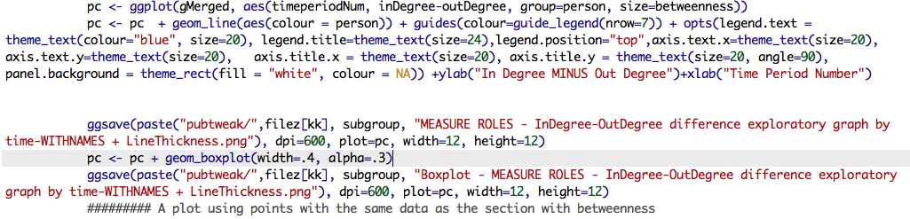
GGPLOT2 Code
pc <- ggplot(gMerged, aes(timeperiodNum, inDegree-outDegree, group=person, size=betweenness))
pc <- pc + geom_line(aes(colour = person)) + guides(colour=guide_legend(nrow=7)) + opts(legend.text = theme_text(colour="blue", size=20), legend.title=theme_text(size=24),legend.position="top",axis.text.x=theme_text(size=20), axis.text.y=theme_text(size=20), axis.title.x = theme_text(size=20), axis.title.y = theme_text(size=20, angle=90), panel.background = theme_rect(fill = "white", colour = NA)) +ylab("In Degree MINUS Out Degree")+xlab("Time Period Number")

Slide 51
Github Longitudinal

Slide 52
GGPLOT2 Code
pc <- ggplot(gMerged, aes(timeperiodNum, inDegree-outDegree, group=person, size=betweenness))
pc <- pc + geom_line(aes(colour = person)) + guides(colour=guide_legend(nrow=7)) + opts(legend.text = theme_text(colour="blue", size=20), legend.title=theme_text(size=24),legend.position="top",axis.text.x=theme_text(size=20), axis.text.y=theme_text(size=20), axis.title.x = theme_text(size=20), axis.title.y = theme_text(size=20, angle=90), panel.background = theme_rect(fill = "white", colour = NA)) +ylab("In Degree MINUS Out Degree")+xlab("Time Period Number")

Slide 53
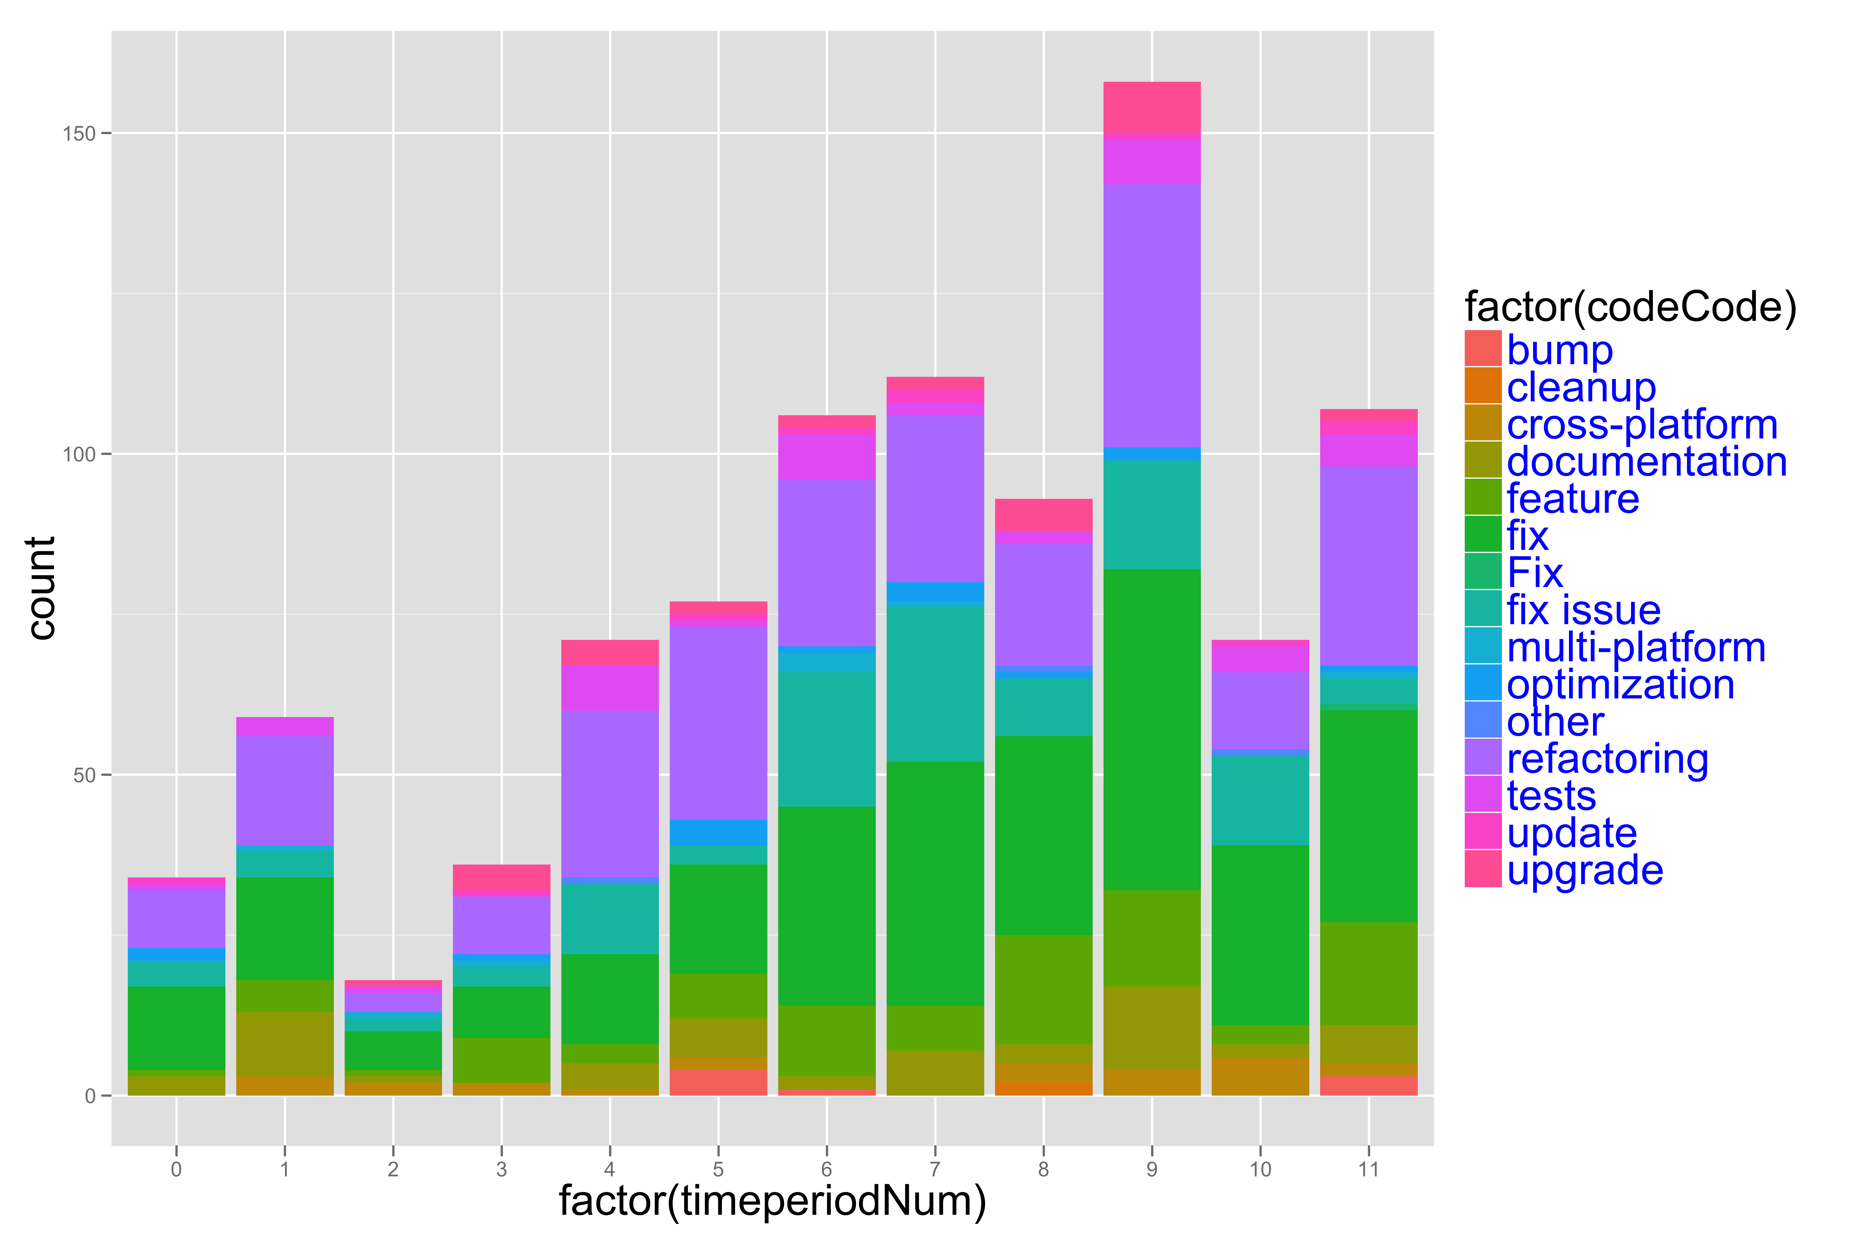
GITHUB: Types of Work

Slide 54
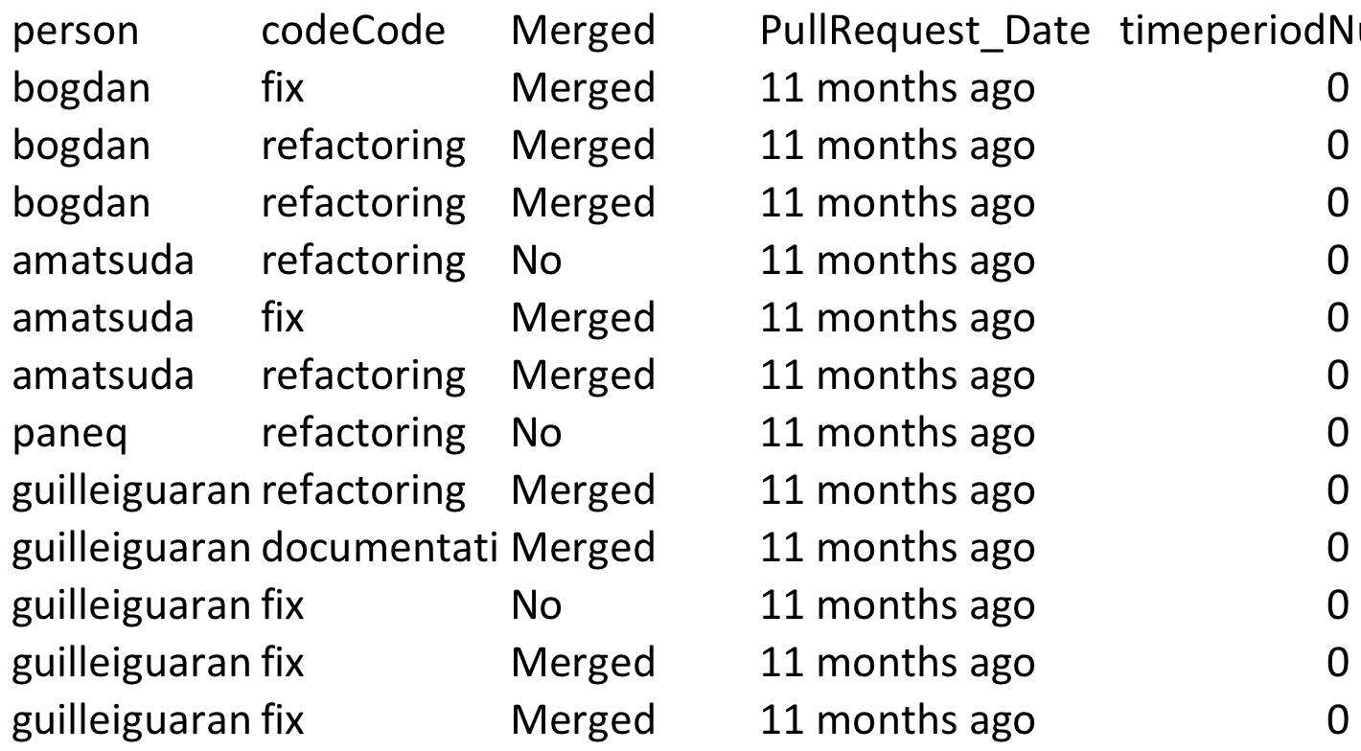
Code & Data for Types of Work
gg <- ggplot(pullerListTyped, aes(timeperiodNum, fill=person))+geom_bar()+facet_grid(facets=codeCode~.)
ggsave("fix-feature-pullers.png", dpi=600, plot=gg, width=12, height=12)

Slide 55
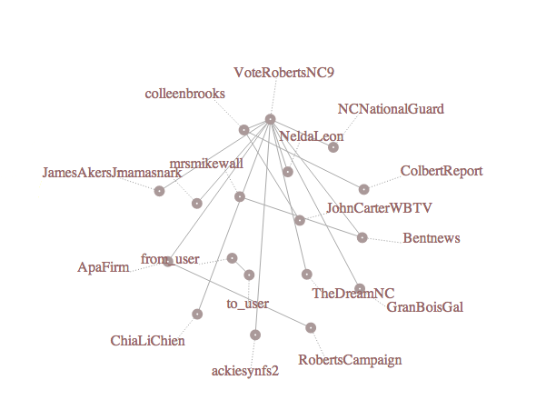
Twitter: Live Visualization of Direct Message Networks

